Slide 1
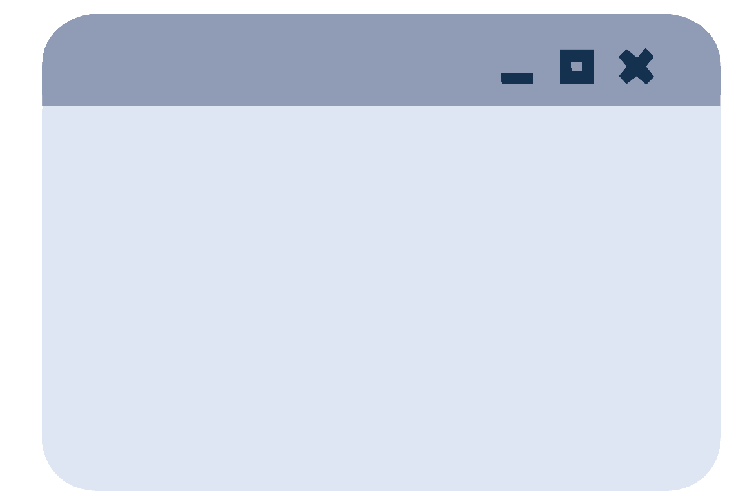
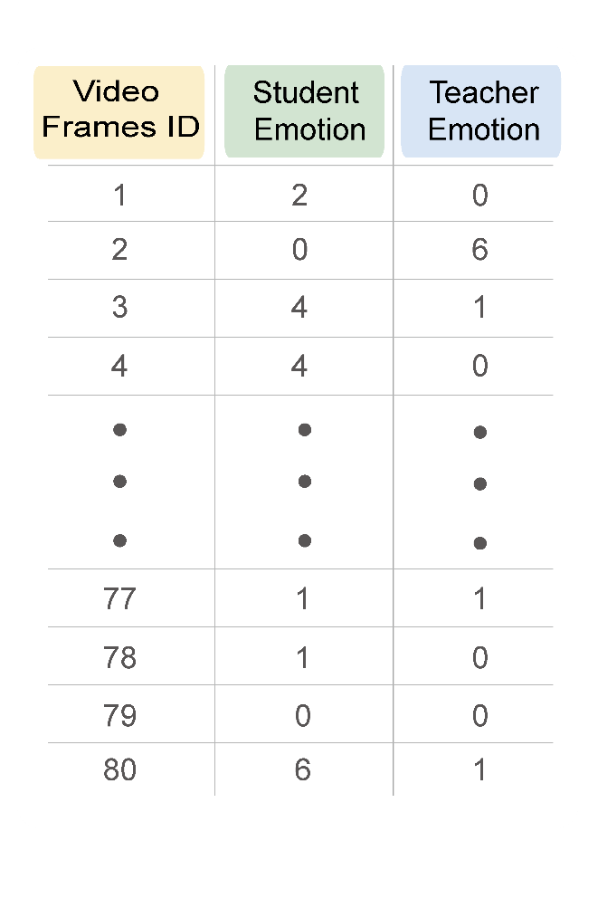

問題描述
研究方法
研究結果與分析
結論與未來展望
系統介紹
# Log
Feature
Predict the score of every 80 ^{seconds}
Score: 4.62 --- Round 1
TimeStep
Score: 4.52 --- Round 2
Score: 4.67 --- Round 3
FC
Score: 4.72 --- Round 4
…
User-end
LSTM
Teaching Satisfaction Score
Shape:( 1, 80, 2)
Score: 1~5
Batch
Input
Model
Output
‹#›

